Slide 1
Waste Reduction, Refuse, Reuse and Recycling (4R) practices in healthcare waste
The circular economy, monitoring and tracking, and digitising HCWM information systems
Dr. Sumitra Amatya - Chairperson, Lead Nepal and International Science
and
Ruth Stringer - Policy Coordinator, Health Care Without Harm

Slide 2
Presentation Outline
Back ground
Environmental Issues
Need of HCWM
Challenges and Opportunities
Way forward: Recourses Recovery or Circular Economy

Slide 3
Back ground: Environmental Issues in Cities
Pollution Control
Waste Management.
Climate Change related issues :
Improved WM on Reducing GHG Emissions across the Economy 15-20%
9% Worldwide GHG emissions
a) Air Pollution | b) Water Pollution
Noise pollution | d) Dust pollution
Municipal Solid Waste | Plastic Waste
Electronic Waste | Bio-Medical Waste
Hazardous Waste | f) Demolition & Disaster Waste

Slide 4
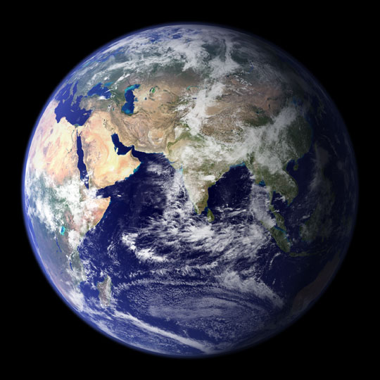
What Happening Around the World?
Unsafe water
Biological threats
Contaminated food
Toxic chemicals
Poor sanitation
Radiation
Hazardous wastes
Air pollution
Climate change
Ozone depletion
…getting sick!…

Slide 5
Need of Proper Healthcare Waste Management
Infectious Waste+ Health Care Waste + Hospital Waste + City Garbage
Current Scenario
City Garbage Waste
1.3 billion ton of waste/year
Uncollected solid waste is often leading contributor to Local flooding, air pollution, water pollution, health impact, Global environment and economy.
Results
Air pollution,
Water Pollution,
River Pollution
Soil Pollution,
Spread disease
Degrade Environment
City Garbage
Hospital Waste
Hospital Waste
Health Care Waste
Infectious Waste

Slide 6
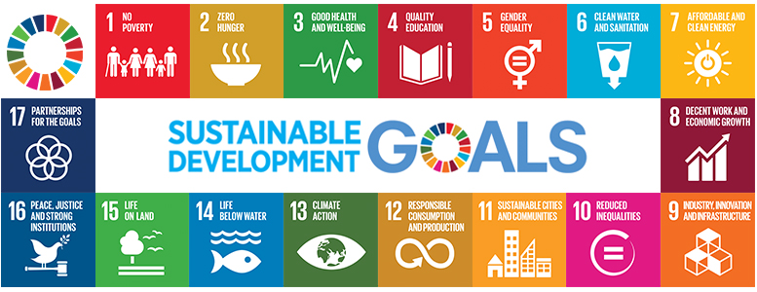
Need of Proper Healthcare Waste Management
SDG 3: Good Health and Well-being
Notes:
o; nIon] ;g\ @)@) ;Dddf ;dfj]lztf, ;|f]tsf] bIftf, lg/fs/0f / hnjfo' kl/jt{gl;t cg's"ng ;DaGwdf gLlt tyf of]hgf ckgfO{l tgsf] sfof{Gjog dfkm{t -;fy} ;g\ @)#) ;Dddf ljkb\l;tsf] pTyfgzLntf_ ljkb\x?sf] sf/0fn] x'g] ljZjAoflk s"n ufx{:y pTkfbgsf] x|f;df kof{Kt sdL NofpFb} ljkb\af6 k|efljt hg;+Vof tyf d[tssf] ;+Vofdf pNn]vgLo ?kdf sd ub{5.

Slide 7
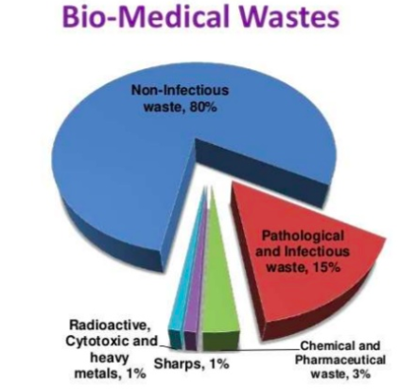
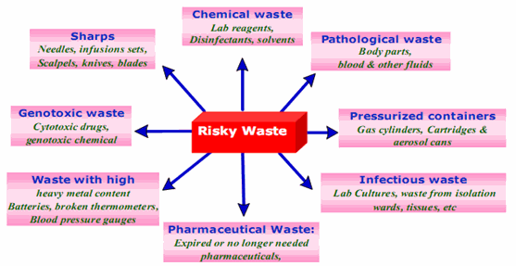
Classification and composition of HCW

Slide 8
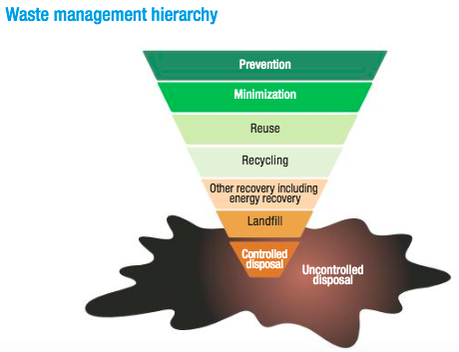
Need of 4R practices in HCWM
Reduction
Refuse
Reuse
Recycle
Disaster ??

Slide 9
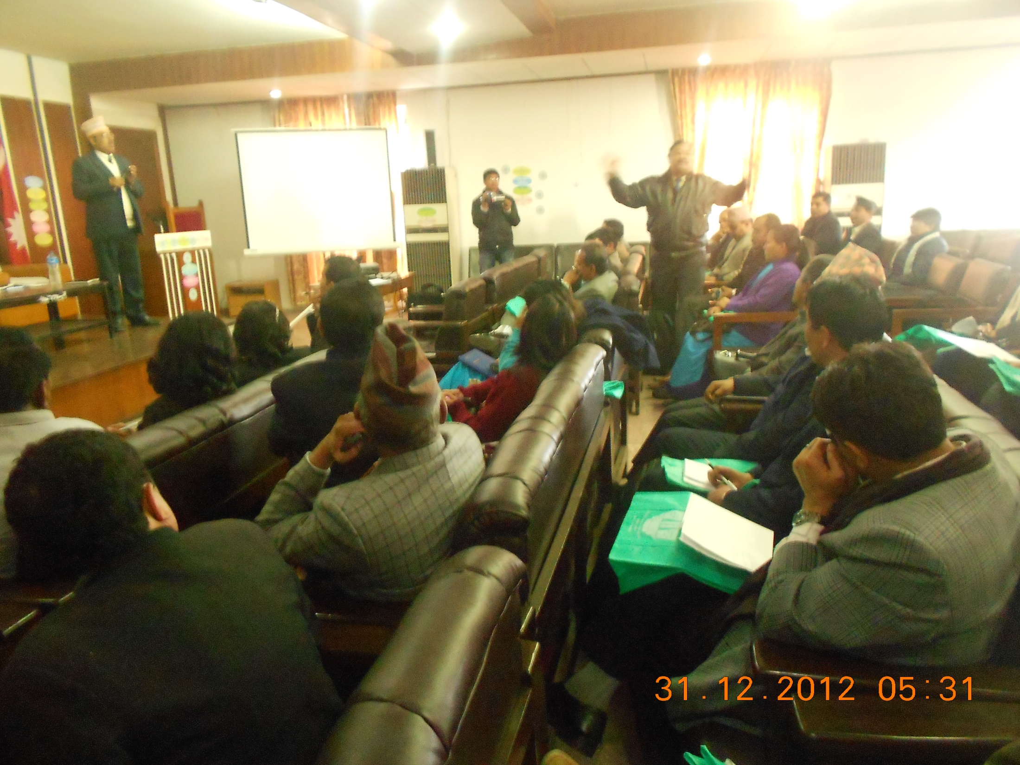
Nepal Government warns: Hospitals to manage HCW strictly.

Slide 10
With Hospital management team at Harkha Gurung hall / NPC

Slide 11
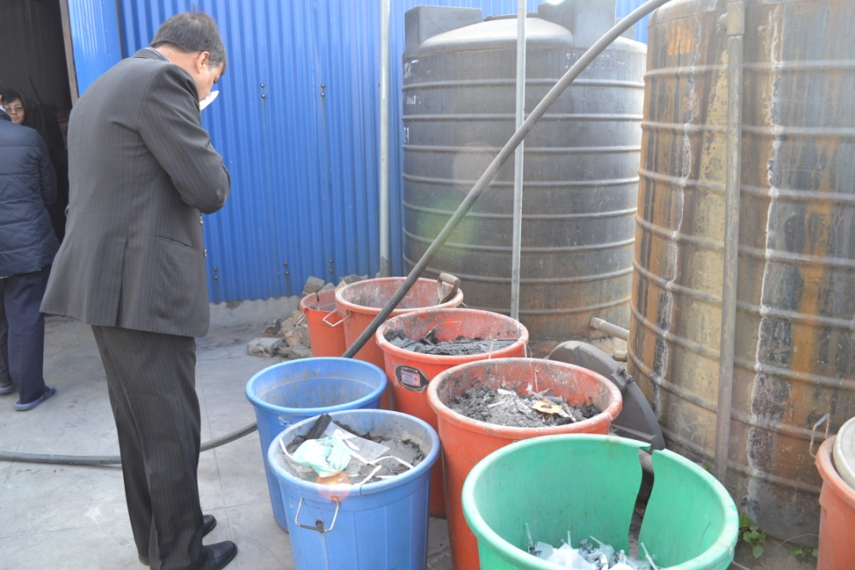
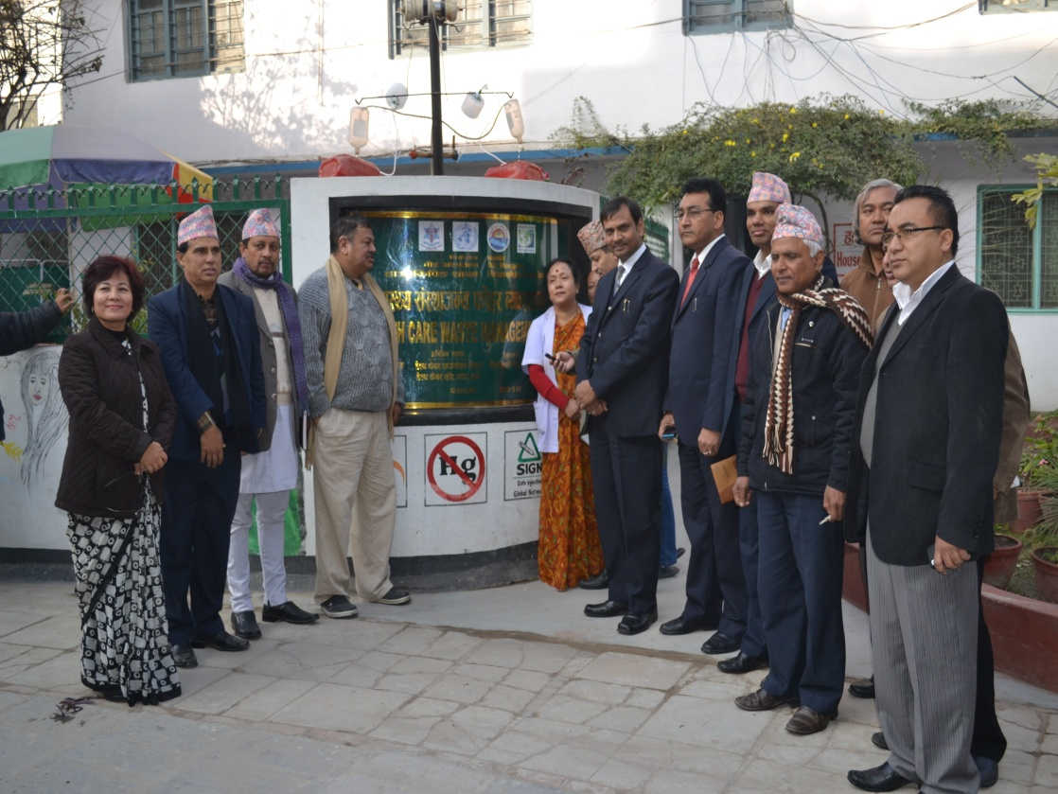
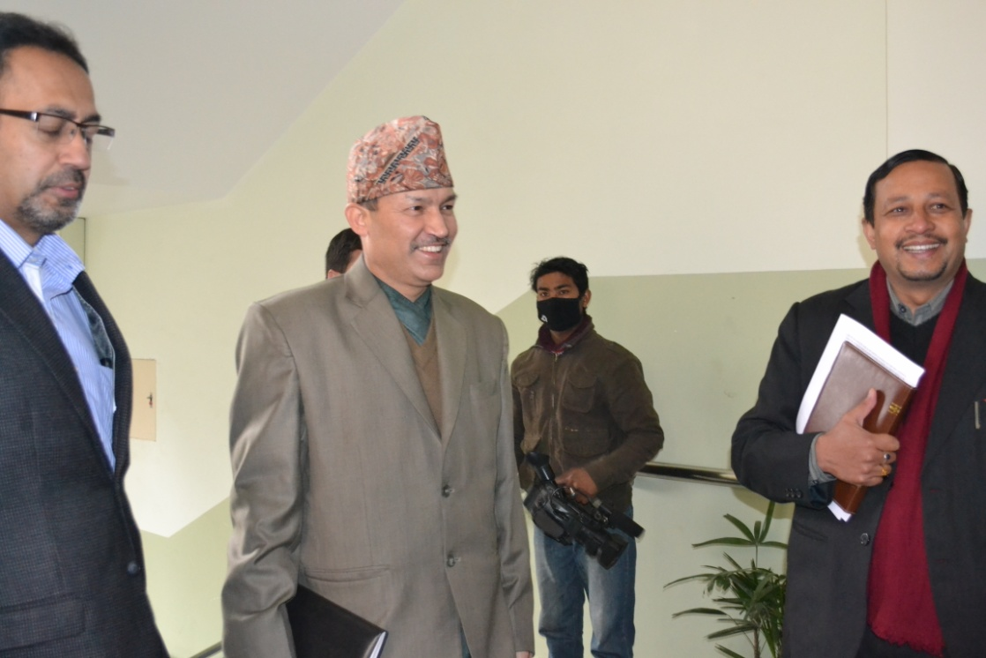
Monitoring and Evaluation Hospitals in Kathmandu

Slide 12
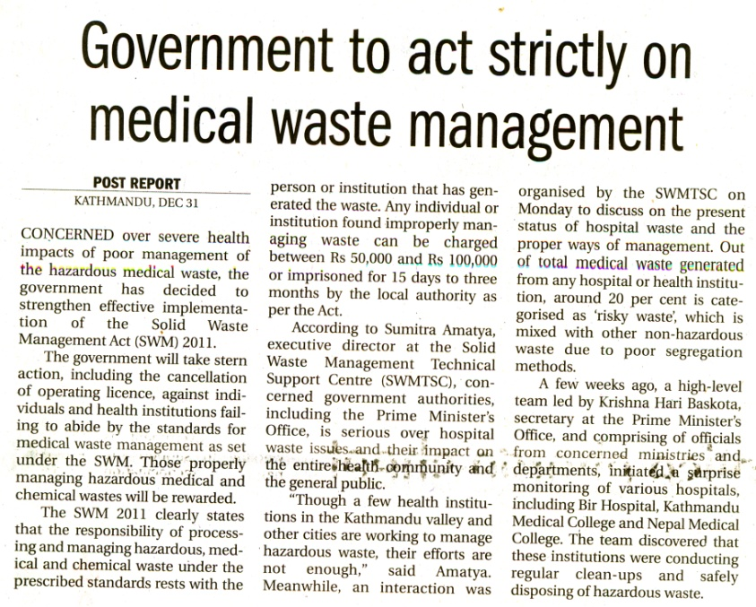
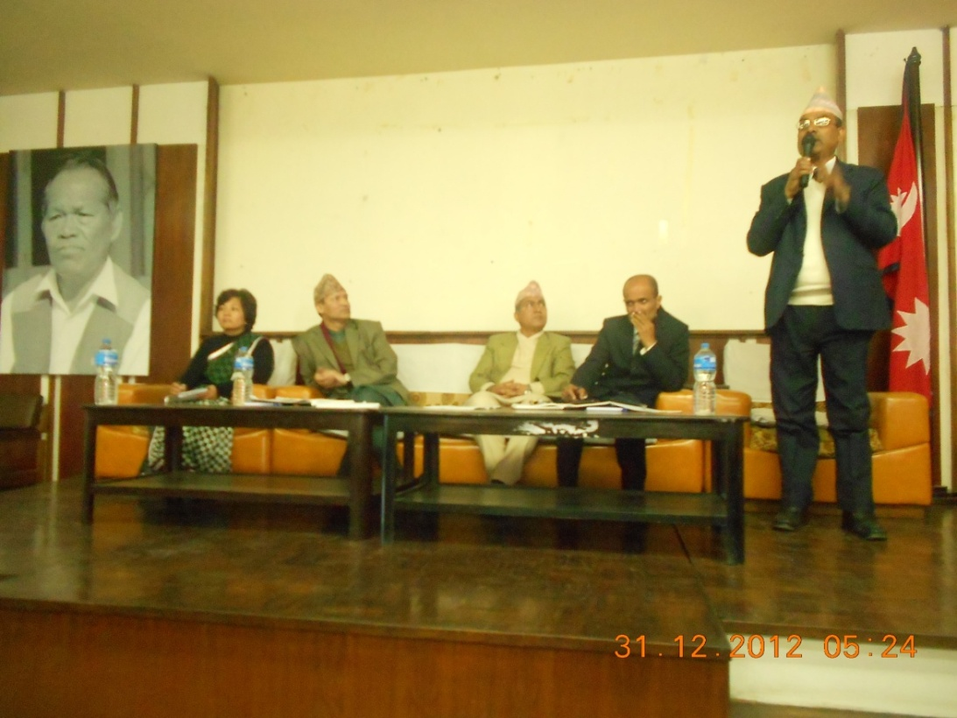
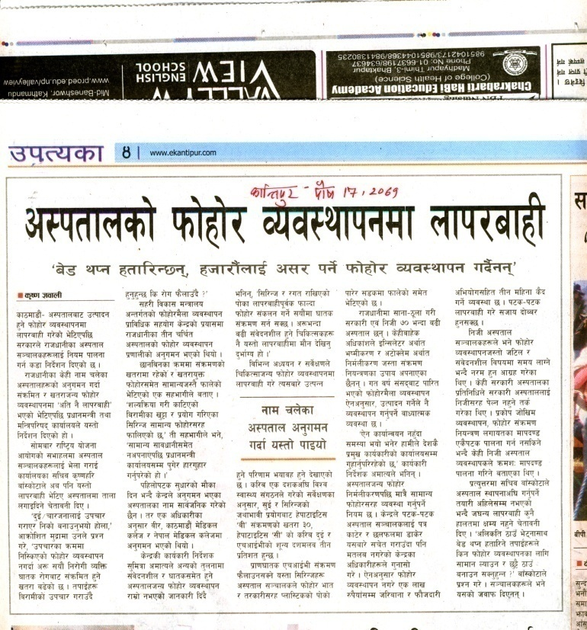
Media Coverage:

Slide 13
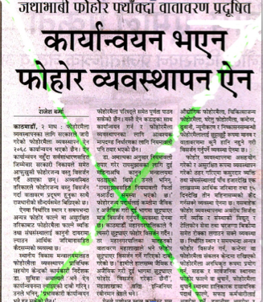
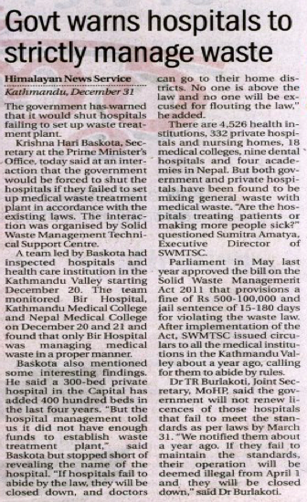
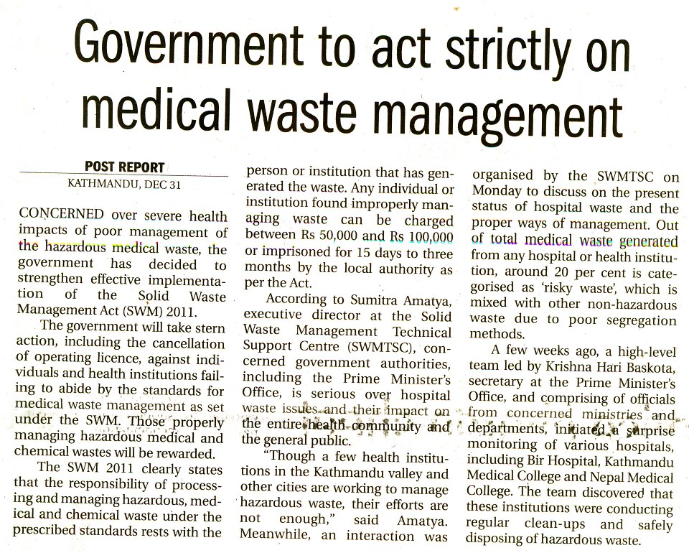

Slide 14
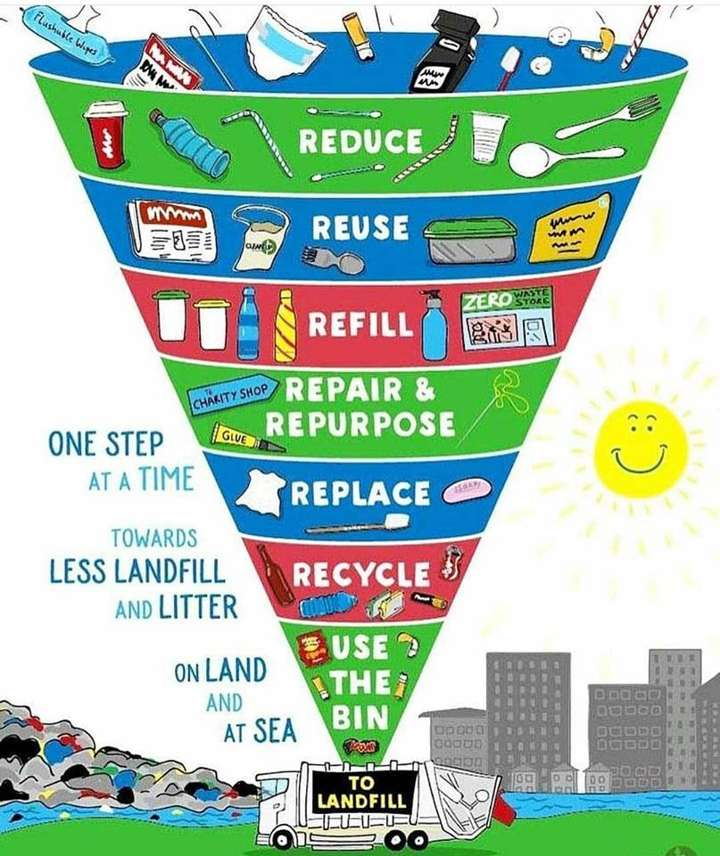
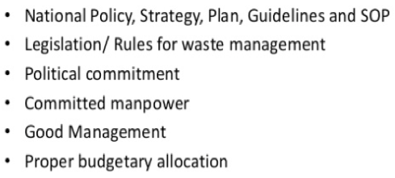
Challenges in HCWM
Data gap is the main challenge in waste management
Archiving of the data
Duplication of the same task
Validation of the data
Perception towards waste

Slide 15
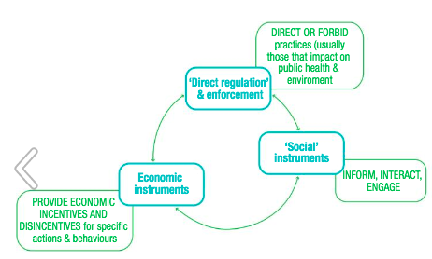
Opportunities in HCWM
1. Employ a sustainability officer and get staff involved
2. Reuse surgical equipment where
Possible
3. Recycle better
4. Avoid potent an aesthetic greenhouse gases
5. Advocate and collaborate towards a low-carbon, low-waste system
Policy Instrument for 4R Practices
Five Steps to reduce environmental footprint
RESOURCE RECOVERY OR CIRCULAR ECONOMY

Slide 16
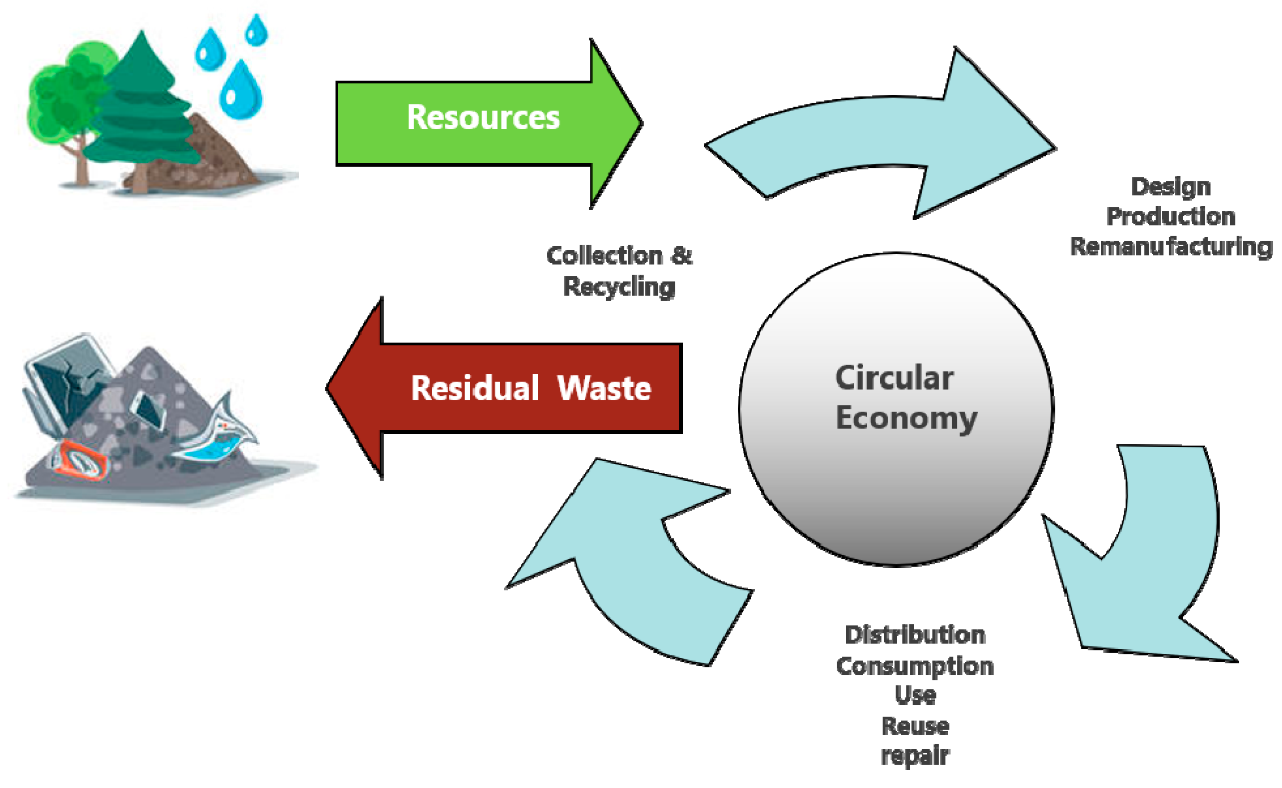
Circular Economy, as an opportunities in HCWM
Big Data Analysis
Data generation
Analysis
Design
Implementation
Artificial Intelligence Public Awareness Develop capacity of all level
The Internet of things
Data bank
EMIS
Frontier Technology
Data Management and archiving- smooth
Time saving
Preserve natural resources
Promote Circular economy
Notes:
o; nIon] ;g\ @)@) ;Dddf ;dfj]lztf, ;|f]tsf] bIftf, lg/fs/0f / hnjfo' kl/jt{gl;t cg's"ng ;DaGwdf gLlt tyf of]hgf ckgfO{l tgsf] sfof{Gjog dfkm{t -;fy} ;g\ @)#) ;Dddf ljkb\l;tsf] pTyfgzLntf_ ljkb\x?sf] sf/0fn] x'g] ljZjAoflk s"n ufx{:y pTkfbgsf] x|f;df kof{Kt sdL NofpFb} ljkb\af6 k|efljt hg;+Vof tyf d[tssf] ;+Vofdf pNn]vgLo ?kdf sd ub{5.

Slide 17
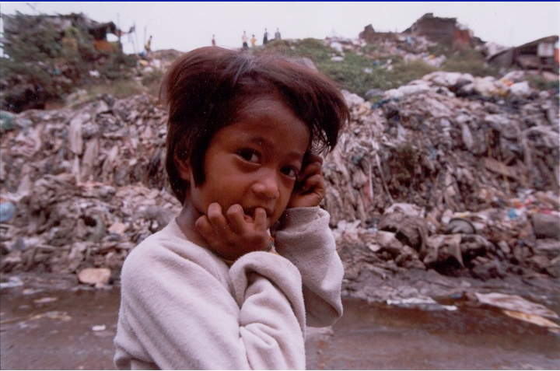
Our Future?

Slide 18
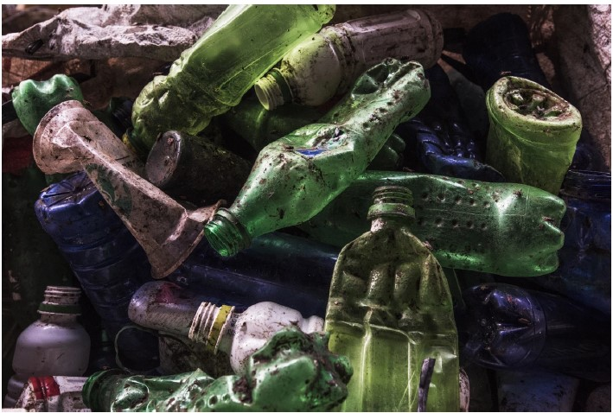
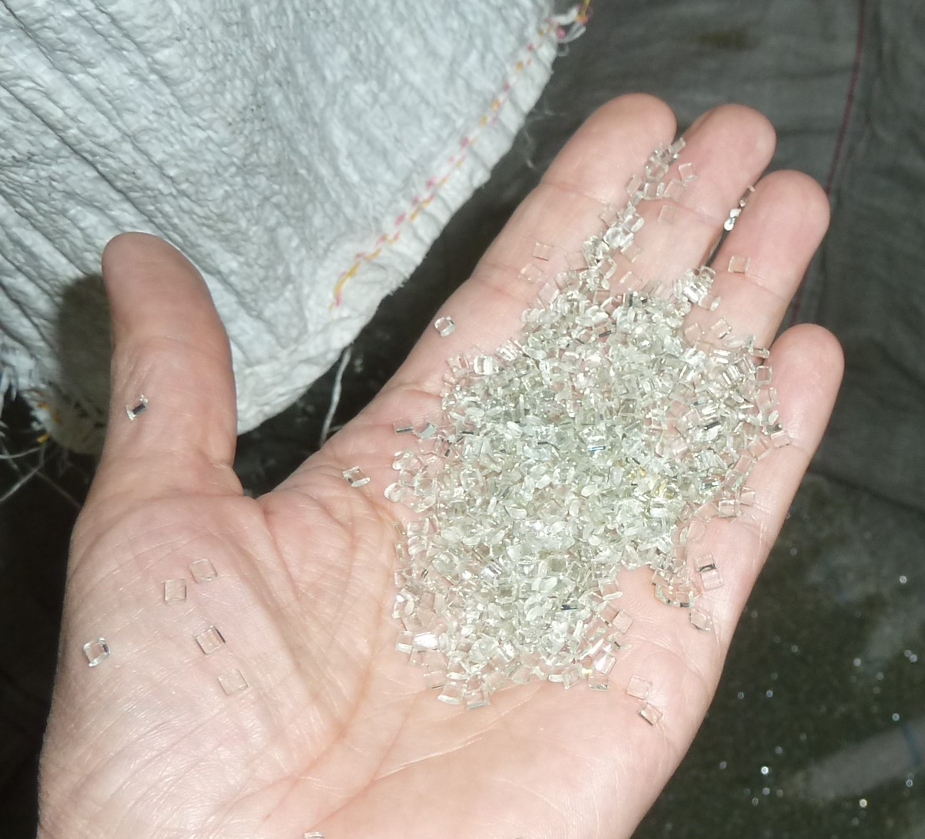
Recycling –pros and cons
Only acceptable for necessary products- waste reduction must come first
Saves resources
Reduces carbon footprint
Reduces dependency on landfill
Only clean, well segregated plastics are safe and economic to recycle
Biodegradable plastics cannot be recycled
Mixed materials cannot be recycled
Sham recycling and legacy toxics
Photo- food grade recycled PET in Pokhara
Photo- mixed and dirty plastics are worthless

Slide 19
Plastics recycling breakdown
Lack of global capacity
Chinese market closure
Basel Convention restricting plastics trade
EU envisions eliminating export for recycling, eliminating some single use items
The US has started burning plastics collected for recycling

Slide 20
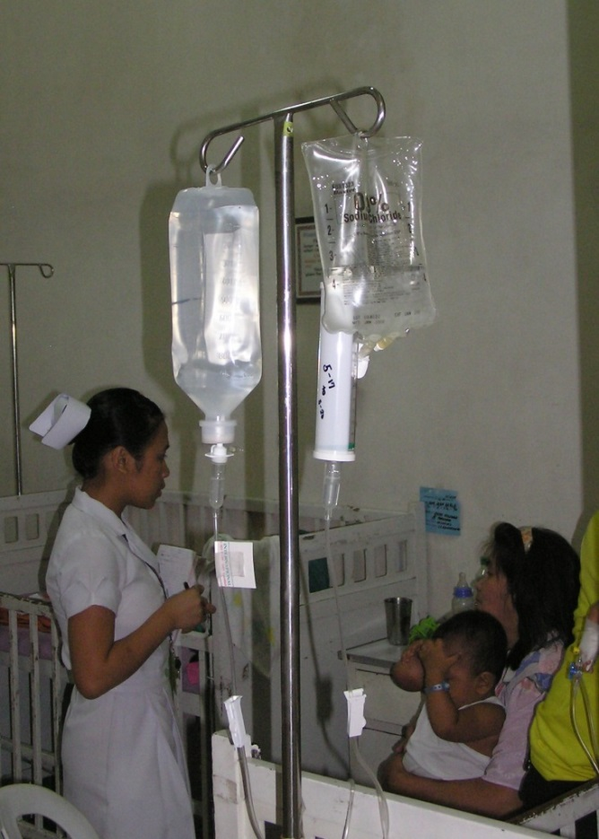
Toxic products should be eliminated, not recycled
http://www.safermedicaldevices.org/

Slide 21
Recycling- not the solution
Healthcare PVC are almost never recycled
EU Vinyloop PVC recycling plant closed June 2018
Legacy toxics contaminate recycled products
Sham recycling
feedstock recycling, waste to energy/energy recovery
Aim to substitute PVC with reusable products wherever possible. But if you must buy disposables, look for the most easily recycled plastics.
Most recycled LDPE, HDPE, PET.
Sometimes recycled PP, PS
Notes:
So if you are not going to burn, how about recycling?
Unfortunately, that is no answer either. First, PVC is almost never recycled. The Vinyl Council of Australia boasts about a recycling project that recycles 200 tonnes of high grade PVC into garden hoses and playground matting. (Messenger 2018). In the UK, a similar industry driven project included six hospitals in 2015 and
collected 719.5 kg of PVC (Vinyl Plus 2016). This is a drop in the ocean. It also targets products- oxygen masks and tubing (VinylPlus 2018) - which are implicated as sources of phthalate contamination on patients (Stroustrup et al 2018)
These “successful” recycling projects are also dependent on a high quality waste stream. The VinyLoop factory in Italy was intended to recycle more difficult PVC waste streams (VinyLoop 2012). Concerns over plasticisers in recycled materials – legacy toxics made the Vinyloop recycling factory in Italy non-viable and it closed in June 2018 (PlastEurope 2018).
Turner 2018- black plastics are partly made from waste electronics and contain contaminants
More plastics waste is burned as recycled Plastics Europe 2017, also http://www.epro-plasticsrecycling.org/pages/75/epro_statistics, https://ec.europa.eu/eurostat/statistics-explained/index.php/Packaging_waste_statistics
“Resource recovery” is a euphemism for incineration
Many PVC recycling processes are in fact burning/pyrolysis (Tukker 1999), Chemical recycling is breaking it down into tars, Rahimi and Garcia 2017
Polymer recycling data – OECD 2018. Global plastics recycling is estimated to be less than 20%

Slide 22
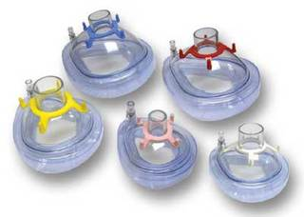
Reusable instead of disposable
Disposable PVC oxygen masks are being targeted for recycling by PVC industry.
But silicone alternatives can be autoclaved and used again.
Polypropylene/thermoplastic elastomer (PP/TPE) alternatives also available
Notes:
Image: https://www.spservices.co.uk/item/Brand_DisposablePVCFaceMask_51_0_2459_1.html
Silicone ones are reusable http://www.fernointernational.com/en/Products/Airway%20and%20Oxygen/masks-and-valves/reusable-silicone-face-mask-in.aspx?ec_trk=followlist&ec_trk_data=masks-and-valves
Autoclavable ones: http://otwo.com/controlled-flow-manual-resuscitators/smart-bag-mo-silicone-autoclavable-bag/ https://www.intersurgical.com/info/eco
file:///C:/Users/Ruth/Documents/Endnote%202017/Original%20files/for%20filing/Plastics/IS10.19_Intersurgical_EcoLite_range_UK_issue_5_web.pdf

Slide 23
Breakdown of plastics by weight and number of items
By number
By weight

Slide 24
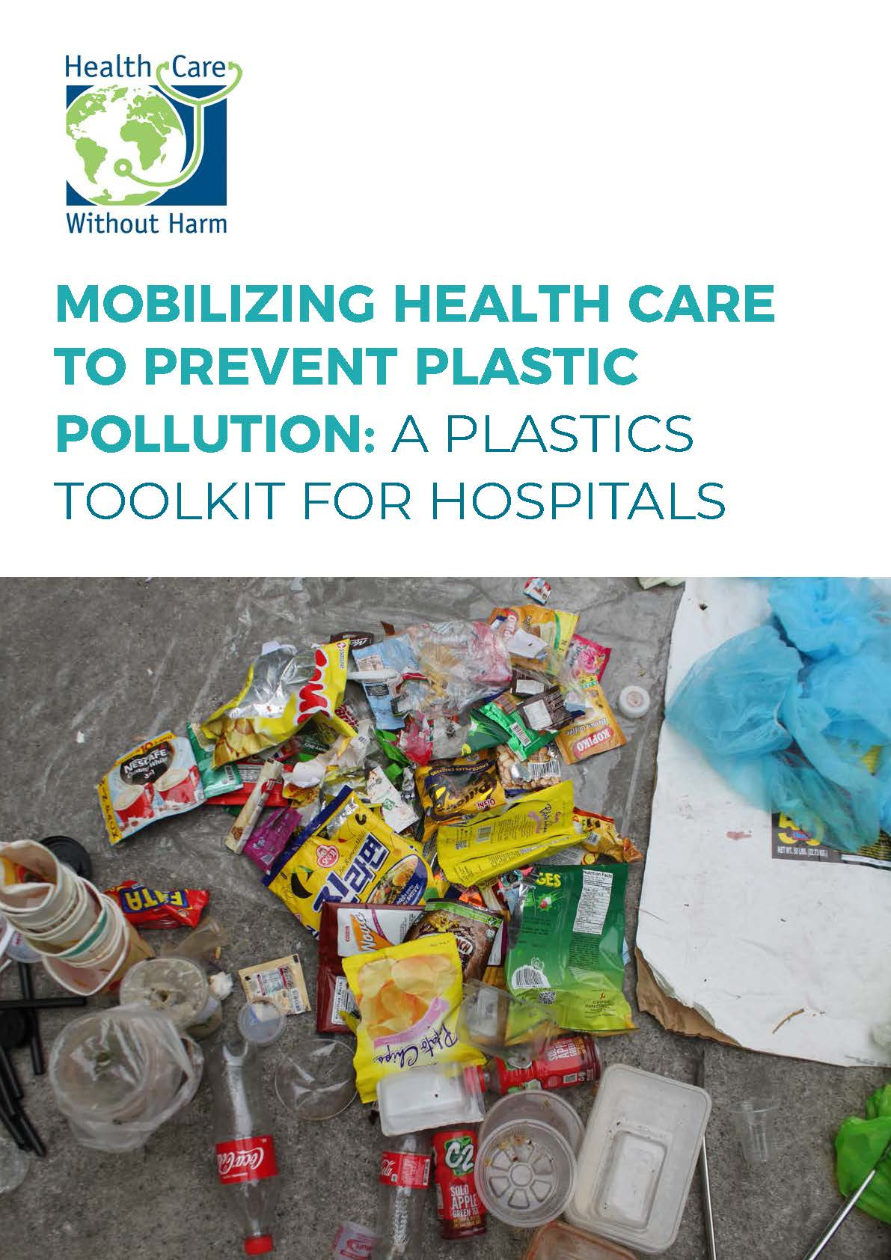
Audit to assess reduction and recycling
Potential reduction and recycling from five Asian hospitals in one year
Recycling
IV bottles- 40 tonnes
Syringes - 13 tonnes
Reduction
Drinks bottles- 27 tonnes
Foodware - 21 tonnes
HCWH Plastics report and toolkit at: http://bit.ly/DownloadPlasticsReport
https://drive.google.com/file/d/1JBmaiqjhPT_4AgFH0uWpwaD4nzLDDElY/view

Slide 25
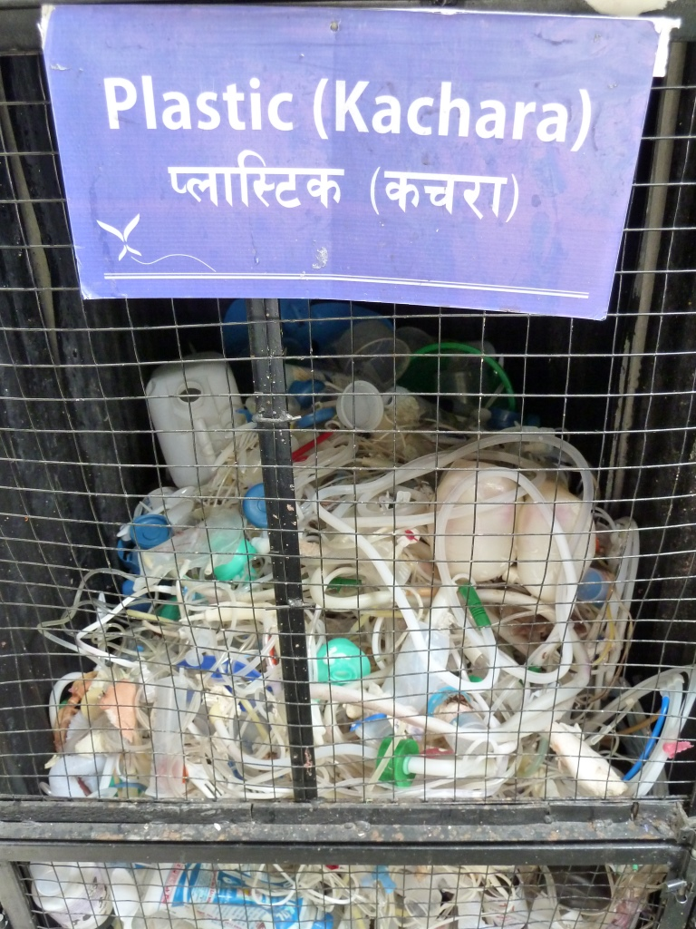
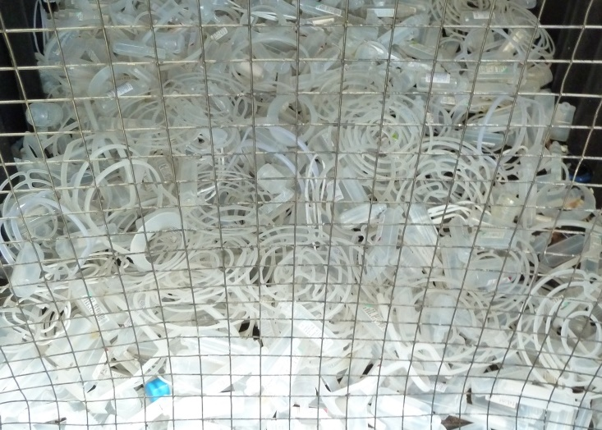
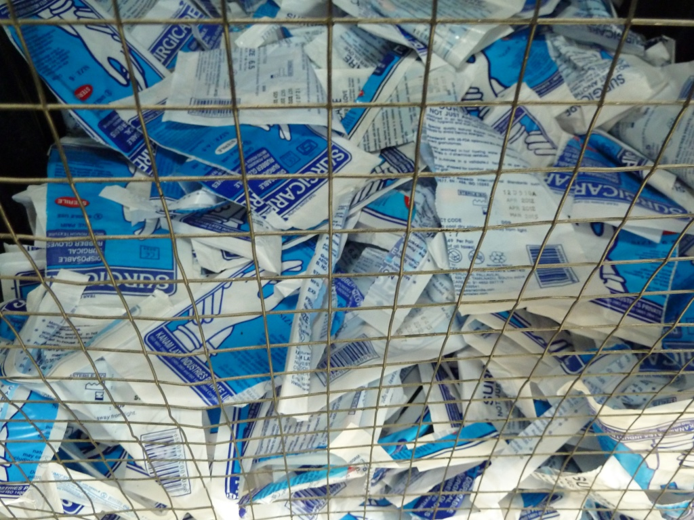

Slide 26
Prices of hospital recyclables, Kathmandu
Price per kg | min | max
Aluminium(Silver) | 115 | 125
X-Ray | 80 | 102
Plastic Guddiya | 61 | 61
Plastic Saline Bottle | 51 | 61
Syringe | 30 | 31
Gallon | 30 | 31
Aluminium foil | 27 | 30
Plastic (Mix) | 20 | 22
Plastic mix (Polythene, PPM, HM) | 20 | 20
Plastic Water Bottle | 14 | 20
Carton | 6 | 9
Plastic Kachara | 8 | 9
Thin Paper | 5 | 8
Thick paper | 4 | 7
Gloves | 5 | 6
Tin (can) | 4 | 6
Glass saline bottles | 0.5 | 1
Aluminium(Cans) | 1 | 1
Other glass | 0.2 | 0.2
Vials | 0.2 | 0.2
Ampoule (Broken glass) | 0.2 | 0.2

Slide 27
Annual waste sales from three Kathmandu hospitals
Total NPR | 988,777.00
Total USD | $ 8,669.68

Slide 28
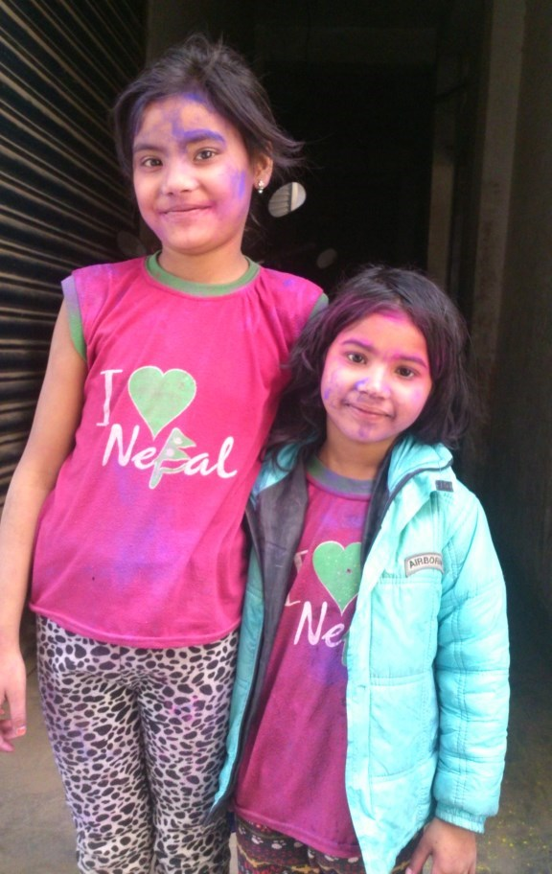
Thank you
More information from
www.noharm.org
rstringer@hcwh.org
www.greenhospitals.net
www.medwastetech.info

